Slide 1

Jose Almeida, BI Consultant
POWER BI DESKTOP
CONNECTING TO DATA SOURCES
DEMO
www.bordalos.com

Slide 2

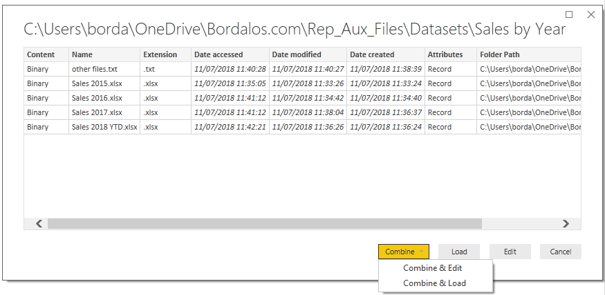
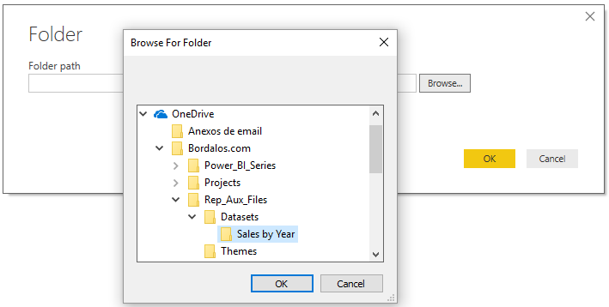



Connect to a Folder
Select Home > Get Data >
files in the folder in binary format
Browse Folder location or past the path
If you change path need to reconnect
Content
Name
Extension
Date accessed
Date modified
Date created
Attributes
Folder Path
Tip #1: filter by Name or Extension to exclude any other files not related to the analysis
Excel objects (worksheets or tables) must have the same name and type of the other files.
Tip #2: filter by Date Modified or Date Created to select based in a relative dates
Notes:
This option is extremely useful. It simplifies considerably the process of importing multiple files into the model and can save us lots of time.
Instead of load the files one-by-one and then appending those in Power Query, connecting to a folder allows us to import multiple files contained in the same folder.
There are some consideration to ensure it works correctly such as all file have the same structure or if excel files, the objects (worksheets or tables) be named the same.
Tip#1 – If because we saved a file in the wrong folder or, if there is any other files in the folder we are connecting to but that are not related to our analysis, we can use the attributes to filter out those before load the data to the model.
In the top right figure we can see there is 4 .xlsx files plus 1 .txt. The former is not related to our analysis and if not excluded it will trigger an error . So let see how to do it (next slide)

Slide 3

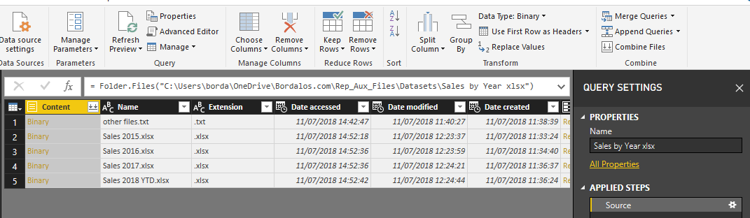
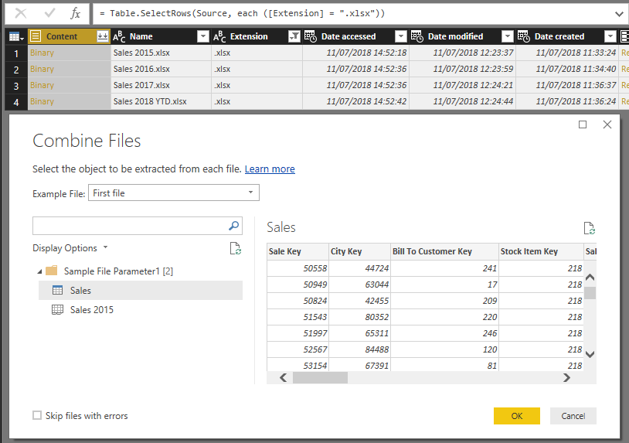
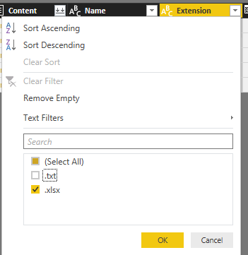

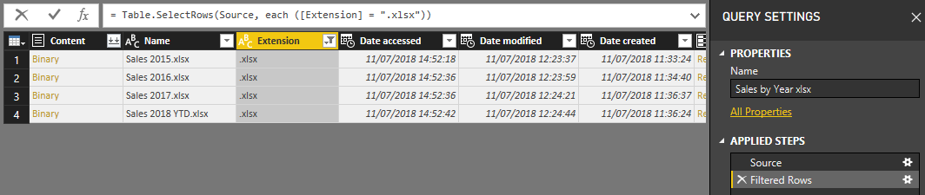
Connect to a Folder - Edit, Filter and Options
Select Edit
4 – Click combine files on content or on combine ribbon to combine the binary files
(a)
2 – Filter Extension and leave only .xlsx selected
(b)
3 – Power Query applied a step where only .xlsx files are pulled out from the folder
(c)
(a) Example File: define witch file will be used as example. By default is the first file.
(b) Choose Object: Table, worksheets, others.
(c) Option to skip file with errors.

Slide 4


Connect to a Folder - Video
Notes:
Connect to a Folder Video : https://youtu.be/YPn7Shh6ods

Slide 5
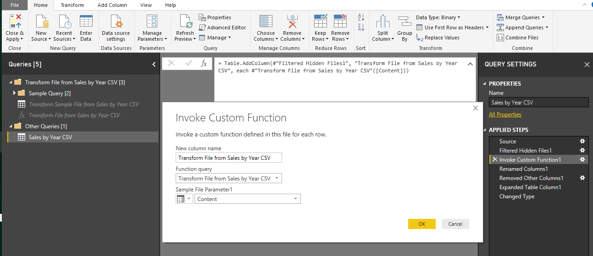
Combine Binary files
(a)
(b)
(d)
(c)
Example query
Function query
Invoke of function query for the list of files on the folder
Combined files result
Apply additional transformation or extraction steps directly to Example Query (a) and any change are automatically reflected in the function query and so in final result as well.

Slide 6
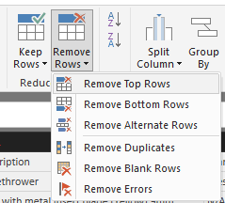
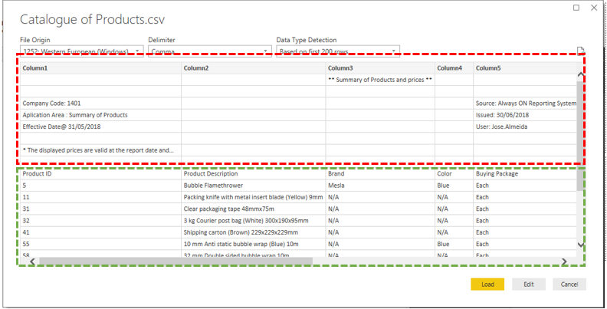
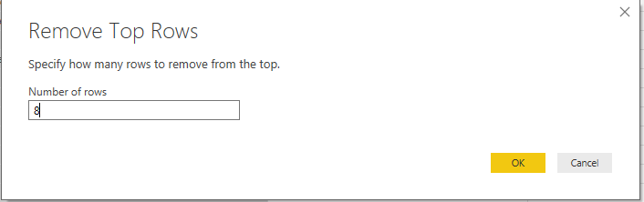
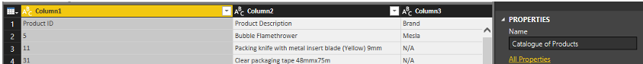
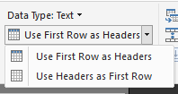
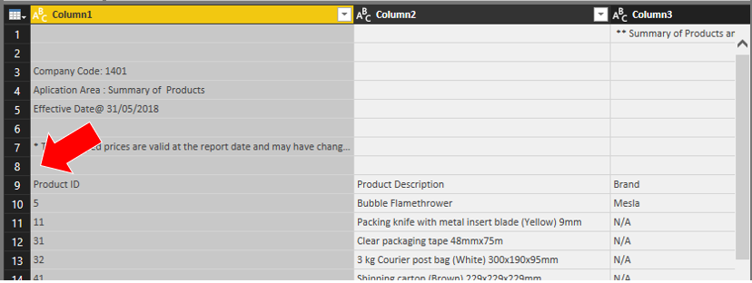

Connect to a CSV/TXT
When data source includes information that is irrelevant for the analysis we must remove it
1 - Select Home > Reduce Rows > Remove Rows > Remove Top Rows
2 - Specify number of rows to be removed
Rows we want to remove
Data we want to keep and load
3 - Home > Transform > Use First Row as Headers
First 8 rows to be removed

Slide 7
Connect to a CSV/TXT - Video
Notes:
Video Remove Top N rows: https://youtu.be/KEz4sHh3G9I

Slide 8
Thank You.
If you want to know more about me please visit bordalos.com
For any inquires please email:
jose.almeida@bordalos.com

